Slide 1
Bitcoin Prices Prediction Model
Sishir Peyyeti, Christopher Avallon, Lucas Barber, Kamilla Toberia, Joey Ditizii

Slide 2
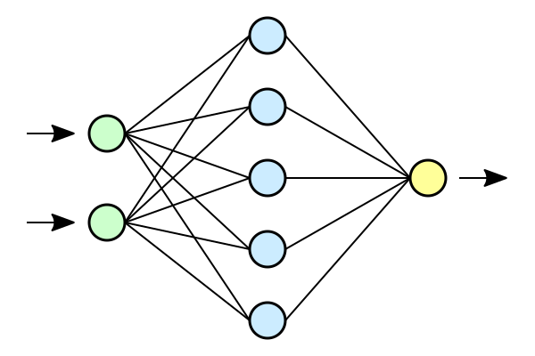
Overview
Neural network algorithm
Our goal was to forecast future prices of Bitcoin using a predictive algorithm based on data retrieved from the past decade
Used a LSTM model

Slide 3
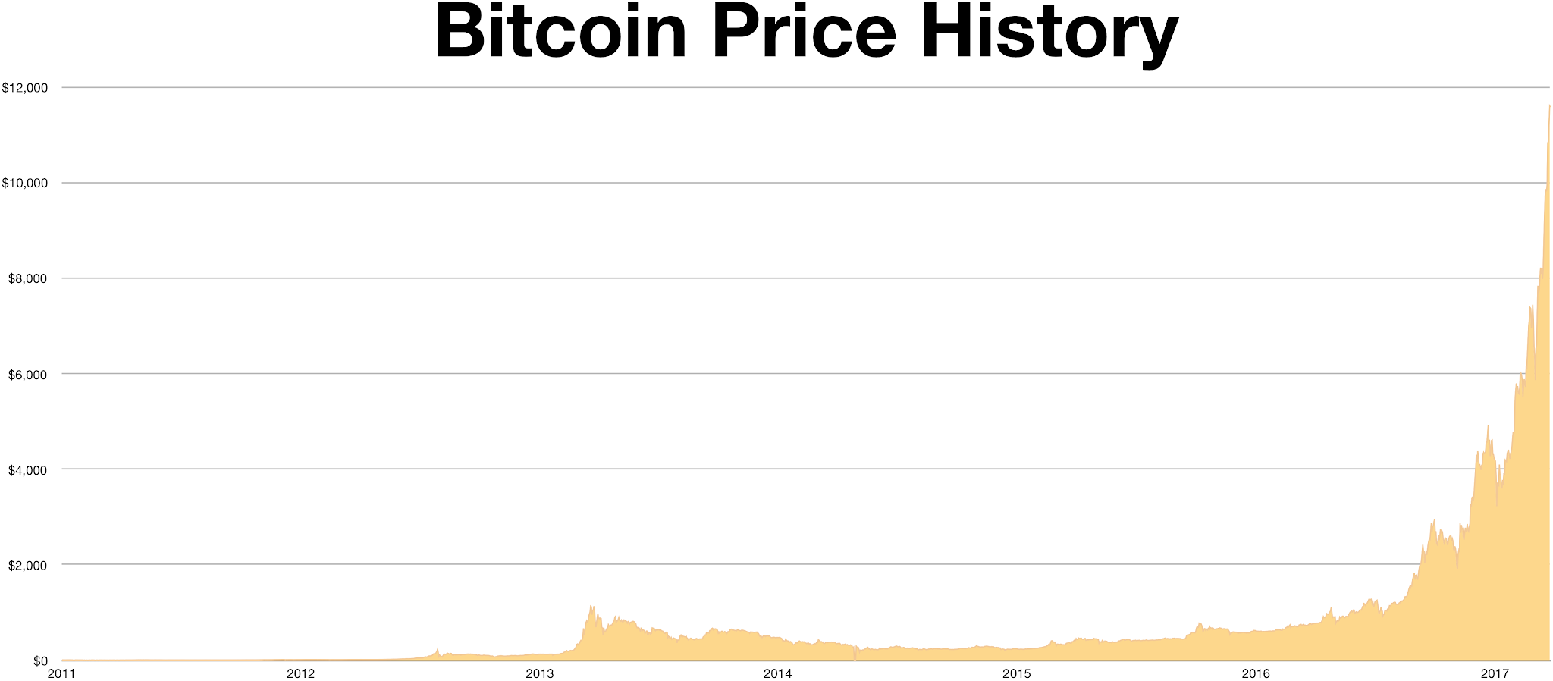
Historical Data
Data was initially from 2010-2024, but we later decided to base our data only on 2023.
First years were very slow for Bitcoin, and exploded in its later years.
The first couple of years of bitcoin would skew the data, since it’s patterns are not similar to the behavior of bitcoin today.

Slide 4
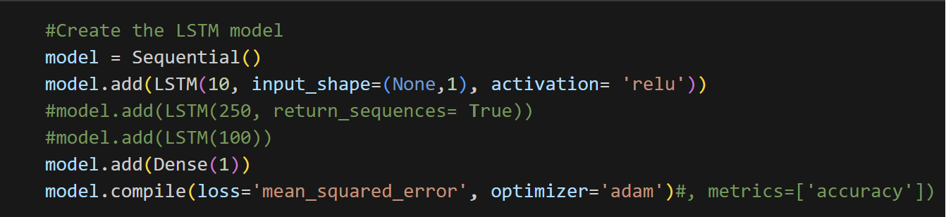
LSTM Model

Slide 5
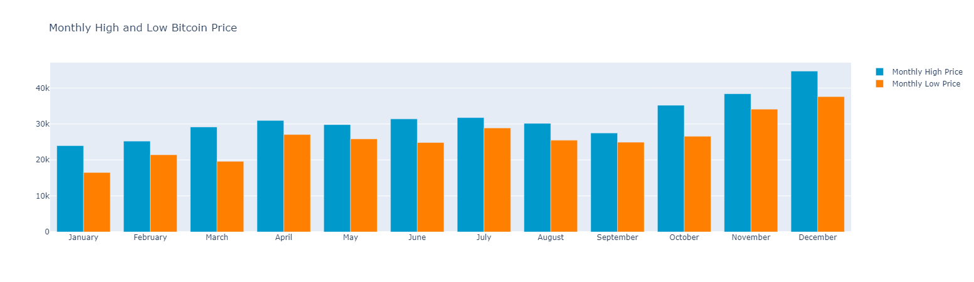
2023 Monthly High and Low
This graph displays Bitcoin's monthly high and low prices in 2023, showcasing its price fluctuations over the year. Each month is represented by a pair of bars, one indicating the high and the other the low. Peaks and troughs in the bars reflect periods of volatility, providing insights into market dynamics and trends. This concise visualization enables quick understanding of Bitcoin's price range and volatility, aiding decision-making and trend analysis within the cryptocurrency market.

Slide 6
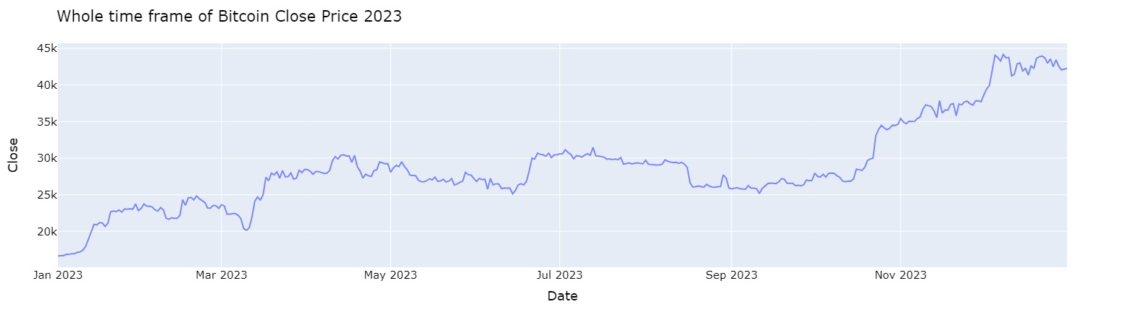
Predicted Price for 2023
The line graph displays the predicted closing prices of Bitcoin for the entirety of 2023, mapping the expected values against the timeline from January to December. This visualization provides a concise overview of forecasted price trends, aiding in investment decision-making by highlighting potential market movements throughout the year.

Slide 7
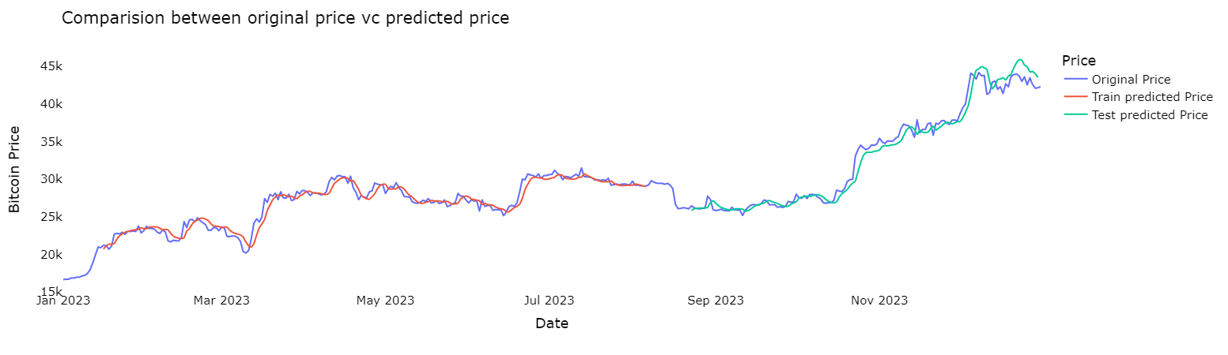
Original Price vs Predicted Price 2023
This line graph depicts the original price versus the predicted price of Bitcoin throughout the year 2023. The x-axis represents the timeline, spanning from January through December, while the y-axis indicates the price of Bitcoin in USD. The graph visually illustrates the comparison between the actual market prices and the predicted values, providing insights into the accuracy of the forecasting model over the course of the year.
The line graph depicts the original price versus the predicted price of Bitcoin throughout the year 2023. The x-axis represents the timeline, spanning from January to December, while the y-axis indicates the price of Bitcoin in USD. The graph visually illustrates the comparison between the actual market prices and the predicted values, providing insights into the accuracy of the forecasting model over the course of the year.
The line graph depicts the original price versus the predicted price of Bitcoin throughout the year 2023. The x-axis represents the timeline, spanning from January to December, while the y-axis indicates the price of Bitcoin in USD. The graph visually illustrates the comparison between the actual market prices and the predicted values, providing insights into the accuracy of the forecasting model over the course of the year.

Slide 8
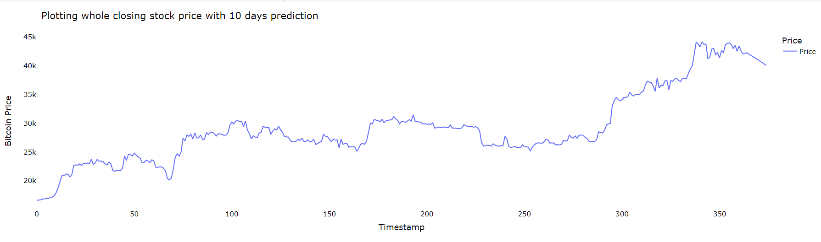
10 Day Future Price Prediction
In this graph, the predicted price data begins on day 364 and extends to day 374. It appears to reveal that there is no drastic difference in the price pattern moving forward when compared to the actual price during this period.

Slide 9

Limitations of the Data
Evaluation rating is high (~0.95) but the forecast is significantly off
Accuracy Concerns
Limited Training Data, not enough data to accurately predict, only used 1 year
External factors on Bitcoin prices (FTX fiasco, etc)

